Slide 1
Machine Learning in Business John C. Hull
Chapter 1
Introduction

Slide 2
What is Machine Learning
Machine learning is a branch of AI
The idea underlying machine learning is that we give a computer program access to lots of data and let it learn about relationships between variables and make predictions
Some of the techniques of machine learning date back to the 1950s but improvements in computer speeds and data storage costs have now made machine learning a practical tool

Slide 3
Software
There a several alternatives such as Python, R, MatLab, Spark, and Julia
Need ability to handle very large data sets and availability of packages that implement the algorithms.
Python seems to be winning at the moment
Scikit-Learn has freely available packages for many ML tasks

Slide 4
Traditional statistics
Means, SDs
Probability distributions
Significance tests
Confidence intervals
Linear regression
etc

Slide 5
The new world of statistics
Huge data sets
Fantastic improvements in computer processing speeds and data storage costs
Machine learning tools are now feasible
Can now develop non-linear prediction models, find patterns in data in ways that were not possible before, and develop multi-stage decision strategies
New terminology: features, labels, activation functions, target, bias, supervised/unsupervised learning……

Slide 6
Types of Machine Learning
Unsupervised learning (find patterns)
Supervised learning (predict numerical value or classification)
Semi-supervised learning (only part of data has values for, or classification of, target)
Reinforcement learning (multi-stage decision making)

Slide 7
Applications of ML
Credit decisions
Classifying and understanding customers better
Portfolio management
Private equity
Language translation
Voice recognition
Biometrics
etc

Slide 8
A Baby Data Training Set (Salary as a function of age for a certain profession in a certain area) Table 1.1
Age (years) | Salary ($)
25 | 135,000
55 | 260,000
27 | 105,000
35 | 220,000
60 | 240,000
65 | 265,000
45 | 270,000
40 | 300,000
50 | 265,000
30 | 105,000

Slide 9
Scatter plot (Figure 1.1)

Slide 10

A Good Fit, Figure 1.2 (Y = Salary, X = Age)
$Y=a+b_{1}X+b_{2}X^{2}$ $+b_{3}X^{3}$ $+b_{4}X^{4}$ $+b_{5}X^{5}$

Slide 11
An Out-of-Sample Validation Set (Table 1.2)
Age (years) | Salary ($)
30 | 166,000
26 | 78,000
58 | 310,000
29 | 100,000
40 | 260,000
27 | 150,000
33 | 140,000
61 | 220,000
27 | 86,000
48 | 276,000

Slide 12
Scatter Plot for Validation Set (Figure 1.3)

Slide 13
The Fifth Order Polynomial Model Does Not Generalize Well
The root mean squared error (rmse) for the training data set is $12,902
The rmse for the test data set is $38,794
We conclude that the model overfits the data

Slide 14
ML Good Practice
Divide data into three sets
Training set
Validation set
Test set
Develop different models using the training set and compare them using the validation set
Rule of thumb: increase model complexity until model no longer generalizes well to the validation set
The test set is used to provide a final out-of-sample indication of how well the chosen model works

Slide 15

Quadratic Model for Baby Data Set (Figure 1.4)
$Y=a+b_{1}X+b_{2}X^{2}$

Slide 16

Linear Model for Baby Data Set (Figure 1.5)
$$Y=a+b_{1}X$$

Slide 17
Summary of Results: The linear model under-fits while the 5th degree polynomial over-fits (Table 1.3)
 | Polynomial of degree 5 | Quadratic model | Linear model
Training set | 12, 902 | 32,932 | 49,731
Validation set | 38,794 | 33,554 | 49,990

Slide 18
Overfitting/Underfitting; Example: predicting salaries for people in a certain profession in a certain area (only 10 observations)
Overfitting
Underfitting
Best model?

Slide 19
Test Set Results for Quadratic Model
Age (years) | Salary ($) | Predicted salary ($) | Error ($)
26 | 110,000 | 113,172 | −3,172
52 | 278,000 | 279,589 | −1,589
38 | 314,000 | 232,852 | +83,148
60 | 302,000 | 264,620 | +37,380
64 | 261,000 | 245,457 | +15,543
41 | 227,000 | 249325 | −22,325
34 | 200,000 | 199,411 | +589
46 | 233,000 | 270,380 | −37,380
57 | 311,000 | 273,883 | −37,117
55 | 298,000 | 277,625 | +20,375
SD of error is $34,273

Slide 20
Typical Pattern of Errors for Training Set and Validation Set

Slide 21
Cleaning data (page 14-16)
Dealing with inconsistent recording
Removing unwanted observations
Removing duplicates
Investigating outliers
Dealing with missing items

Slide 22
Bayes Theorem (useful when we want an uncertainty estimate as well as just a prediction)
Example: We observe that 90% of fraudulent transactions are for large amounts late in the day. Also 3% of transactions are for large amounts late in the day and 1% of transactions are fraudulent

Slide 23
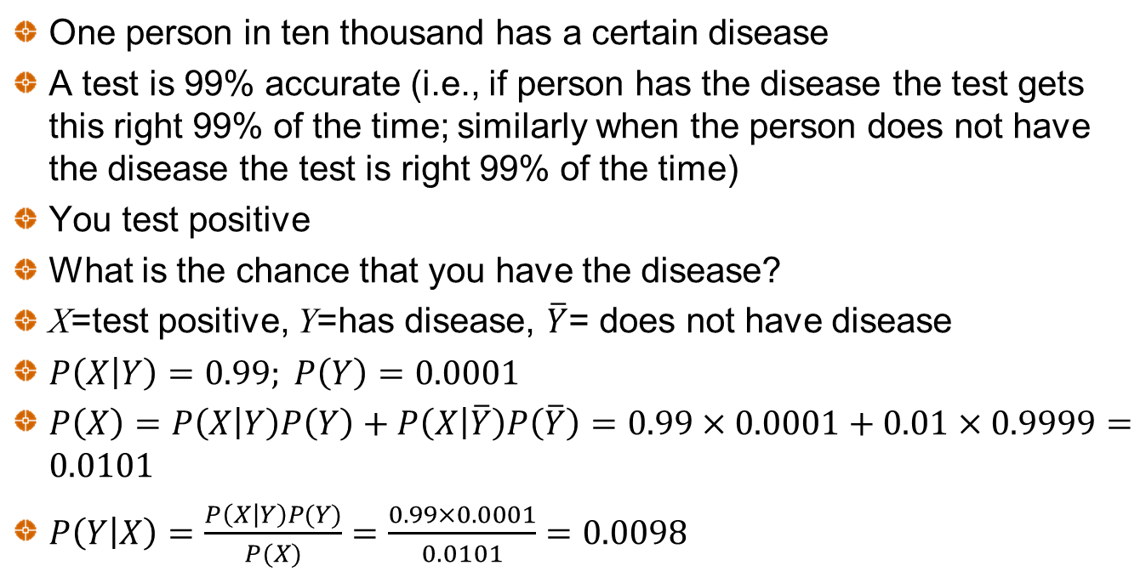
Bayes can be counterintuitive
One person in ten thousand has a certain disease
A test is 99% accurate (i.e., if person has the disease the test gets this right 99% of the time; similarly when the person does not have the disease the test is right 99% of the time)
You test positive
What is the chance that you have the disease?
X=test positive, Y=has disease, $\overline{Y}$= does not have disease
$P\left(\left.X\right|Y\right)=0.99; P\left(Y\right)=0.0001$
$P\left(X\right)=P\left(\left.X\right|Y\right)P\left(Y\right)+P\left(\left.X\right|\overline{Y}\right)P\left(\overline{Y}\right)=0.99×0.0001+0.01×0.9999=0.0101$
$P\left(\left.Y\right|X\right)=\frac{P\left(\left.X\right|Y\right)P(Y)}{P(X)}=\frac{0.99×0.0001}{0.0101}=0.0098$

Slide 24
The Terminology
Features
Target
Labels
Supervised learning
Unsupervised learning
Semi-supervised learning
Reinforcement learning
And more to come..

